Slide 1
INTERPROFESSIONAL COLLABORATION
Modified from a module created by the University of British Columbia Birth Place Lab and adapted by the University of California at San Francisco
Notes:
Concepts introduced in the Teamwork module are closely related to many of the themes and issues we covered in the Person-Centered Decision Making and Communication modules. In this module, you will be guided through Florence's story. We will use Florence's story to demonstrate how and when to apply key steps and tools that support effective and positive teamwork during person-centered decision making (PCDM). As you are introduced to the skills, you will be able to check your understanding through knowledge checks and personal reflections. Discussion questions, writing activities, a quiz, and audio files of role plays of teamwork tools will provide you with opportunities to apply what you have learned. We invite you to discover the connections between elements presented in other modules in this course.

Slide 2
OBJECTIVES
Identify and discuss strategies to enhance team functioning and interprofessional collaboration.
Discuss key principles for optimal team functioning.
Interpret the steps in a role clarification process and discuss professional roles of the maternity team.
Reflect on personal, situational, and professional contributions to team processes.
Apply tools that support effective team functioning, team characteristics, and team processes.

Slide 3
COMMON PROVIDERS IN PERINATAL CARE
Primary providers (family physicians, midwives, and obstetricians)
Perinatal specialist providers (neonatologists, maternal fetal medicine specialists)
Collaborating providers for labor and birth (labor and delivery nurse, anesthesiologist, Emergency Medical Services, social worker, doula)
Collaborating providers for pregnancy and postpartum (lactation consultant, nutritionist, genetic counselor, public health nurse)
Notes:
Family practice physicians are generalists providing the majority of care for America’s underserved rural and urban populations. They provide comprehensive healthcare for acute and chronic ailments for people of all ages – from newborns to seniors. Family physicians complete a three-year residency program after graduating from medical school. As part of their residency, they receive training in six major medical areas: pediatrics, obstetrics and gynecology, internal medicine, psychiatry and neurology, surgery, and community medicine.
Midwives: CNMs/CMs scope of practice additionally includes prescribing and a breadth of primary, sexual and reproductive healthcare. All midwives work collaboratively with other care providers. If health issues develop over the course of care, they may consult with a specialist (obstetrician, neonatologist, pediatrician, etc). They follow practice guidelines for consultation, co-management and/or transfer of care to an appropriate specialist.
Obstetrics and gynecology are disciplines dedicated to the broad, integrated medical and surgical care of women's health throughout their lifespan. Obstetrician-gynecologists provide care for both uncomplicated and high-risk pregnancies and deliveries
Pediatricians are primary care providers who care for the physical, mental, and social health of children from birth to young adulthood. Pediatric care encompasses a broad spectrum of health services ranging from preventive healthcare to the diagnosis and treatment of acute and chronic diseases. Pediatricians typically attend hospital births only when there is an indication that the baby may need specialized medical care due to a pregnancy or delivery complication.
A neonatologist is trained specifically to handle complex and high-risk neonatal patients. If the newborn is premature, or has a serious illness, injury, or birth defect, a neonatologist may assist at the time of delivery and in the subsequent care of the newborn. If a problem is identified before the baby is born, a neonatologist may become involved to consult with the obstetrician in prenatal care during pregnancy.
Labor and Delivery Nurses provide continuous nursing care in labor and postpartum. Nurses work with midwives and physicians and contribute to the coordination of care
Anesthesiologists provide care during certain types of anesthetic procedures during labor, birth, or postpartum. They assist in the management of pain during labor, as needed, or administer anesthetic for other obstetrical procedures that cannot be done by local anesthetic or a pudendal block.
Emergency Medical Services: The scope of practice for these providers ranges from basic lifesaving interventions and transport to invasive and pharmacological interventions for acute out-of-hospital medical and traumatic emergencies
Lactation consultants are professionals who provide clinical management of breastfeeding, such as feeding assessments and feeding plans based on the needs of infant and lactating parent, advice on medications and complementary therapies while breastfeeding
Nutritionists take a key role in promoting healthy people by reviewing and assessing individual diets to ensure balanced approach to nutrition that will aid in overall health, as well as healthy pregnancies and postpartum
Social workers ensure a more holistic approach to health by addressing each person’s biopsychosocial-spiritual and environmental issues. Social work’s strengths-based, person-in-environment perspective provides the contextual focus necessary for client- and family-centered care.
Genetic counselors utilize information from individual and family histories, genetic laboratory testing or other screening to assess risk for genetic medical conditions or disorders in the patient, their offspring or family members
Please Refer to the Role Clarification module for additional detail about obstetrician gynecologists and midwifes.

Slide 4
CASE STUDY 1: FLORENCE'S STORY
Florence is a 29-year-old pregnant person.
Second pregnancy (has 3-year-old daughter)
Healthy, with no significant medical or surgical history
Florence and partner, Tom, concerned about implications of hospital birth
Florence hopes to deliver at home again with her midwife
Notes:
Refer to full text document for more information

Slide 5
CASE STUDY II: TASMIN’S STORY
A midwife
Caseload includes both pregnant and non-obstetric clients
Provides care to women that extends beyond 6 weeks postpartum, including an expanded scope of care to babies and well-woman care
Occasionally has to travel for continuing education or short-term practice opportunities in high-volume settings
Notes:
Refer to full text document for more information

Slide 6
CASE STUDY III: RIANN’S STORY
A family practice physician
Carries her own obstetric caseload and attends births in the hospital
Tasmin & Riann have an arrangement, discussing every patient at the birth plan
Notes:
Refer to full text document for more information

Slide 7
ACKNOWLEDGING ENVIRONMENTAL NORMS
Environmental factors include:
regional resources
social norms
community standards
institutional routines.
Assessing the available regional resources includes:
The number and location of family doctors, specialists, or midwives
The type and level of facilities (health centers, community hospitals, tertiary care hospitals, emergency services)
Notes:
A key element in the person-centered decision making (PCDM) process is to acknowledge environmental norms, in addition to personalizing the care plan. You can facilitate an understanding of the options available, the benefits and risks of these options, and how to apply these to the patient’s context and values.
Please se Patient Centered Care module for more detail.

Slide 8
WORKPLACE CULTURE: EFFICIENCY OR FEELINGS?
Quality of care delivery depends upon relationships
Time is necessary to establish and maintain relationships
Process Protocols:
Anticipating: What the team members are going to do or expect from each other
Debriefing: review how they functioned as a team after an eve
Notes:
The organization of healthcare in institutions is often focused on efficiency and standardized operating systems, but the actual work of providing care is dependent on the quality of relationships. Building and maintaining positive relationships takes time, focus, and energy; hence ‘relationship’ is often de-prioritized in favor of action and expedience. However, evidence shows that sacrificing the time required to establish and maintain relationships ultimately reduces both efficient delivery of care and provider satisfaction.
To improve team functioning, teams can use “process protocols” by talking about what the team members are going to do or expect from each other and engaging in team debriefs to review how they functioned as a team after an event (1). By anticipating each team member’s expectations, roles, and contributions, and by acknowledging successes and challenges soon after a shared care event, misunderstandings and confusion can be avoided. Well-functioning teams are able to personalize care and problem solve creatively

Slide 9
WORKING CONDITIONS
Workplace based reactions:
Burnout
Compassion fatigue
Vicarious trauma
Moral distress
Lateral stress
Workplace-inspired grief
Depression
Anxiety
Notes:
Working conditions in healthcare also can have a significant impact on the options that are available to service users. Workplace-based reactions like burnout, compassion fatigue, vicarious trauma, moral distress, lateral stress, workplace-inspired grief, depression, or anxiety can affect how care providers relate to each other, how they perform, and how willing they are to individualize care (1).
A holistic model of self-care includes a healthy relationship with oneself, others, and ‘that which brings meaning to one's life’ (21). This means that care providers must find meaning in their work that aligns with their raison d’être (core values).

Slide 10
WORKPLACE REACTIONS
The “Functional Disconnect” from a team is a workplace-based reaction that inhibits team functioning
Emotional disconnect occurs as part of burnout, compassion fatigue, and vicarious or secondary traumatic stress
People develop ways to functionally disconnect so that they can continue their work by protecting themselves through emotional distance
Functional Reconnect Strategy: Look, Listen, Link
Notes:
When considering your own reactions to your workplace conditions, self-awareness is key. If you have an unresolved conflict with a colleague, or are still deeply affected by a clinical "near miss" or adverse outcome, these issues are always present at work and can impede your ability to engage fully in your role. Ways to overcome this and facilitate an “emotional reconnect” include mindfulness and listening to yourself and others.
'Look' means to establish safety through eye contact, turning toward the person, and being present. 'Listen' uses empathy and communication skills. Empathize with what is being said and establish a relationship using verbal communication skills like acknowledging the feelings behind a message. 'Link' strives for expanding the relationship by looking for solutions together and providing resources to support obtaining the solutions

Slide 11
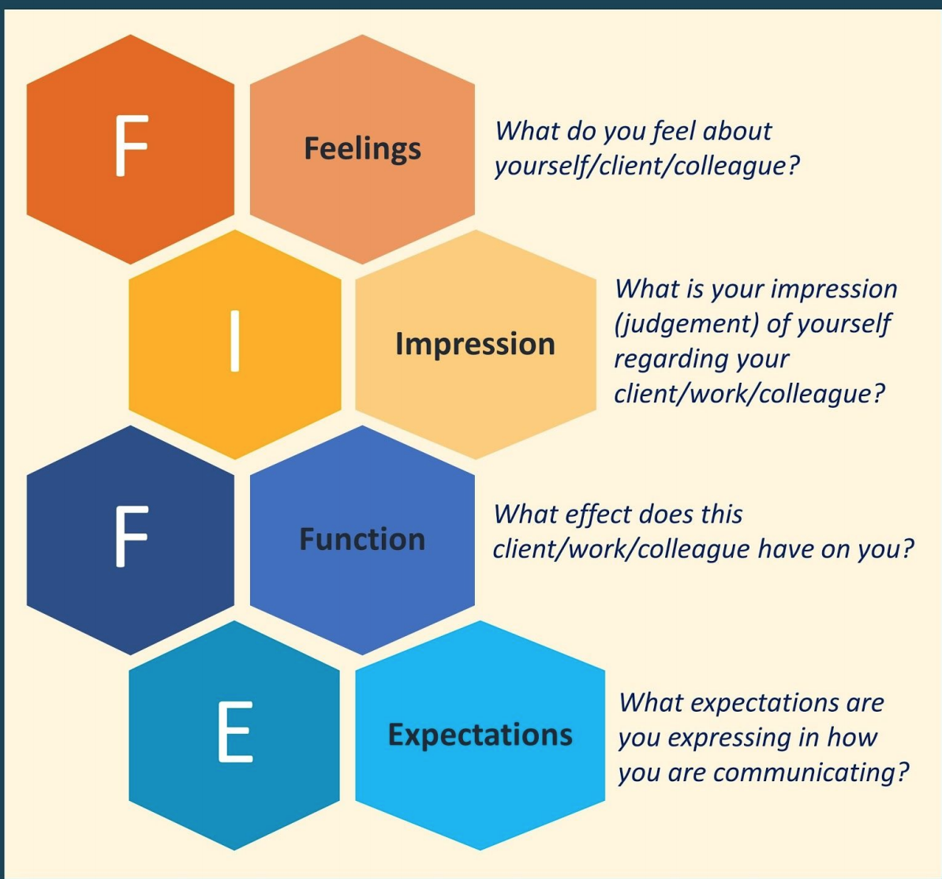
FIFE TOOL
Notes:
FIFE is another tool that you can use to develop self-awareness when working in teams (21). The process includes managing your emotions, tuning in to how you are judging yourself and others, identifying how you are reacting to others, and noting how you are expressing yourself.
Knowledge check for learners here

Slide 12
TEAM-BASED HEALTHCARE
Notes:
Healthcare teams work together in many ways. Some teams work more closely, such as when teams work in an office, clinic, or hospital floor together. Other teams work more remotely from each other, such as in community-based care, primary care, or specialty care. To qualify as a team, people have to work together in one way or another.
High functioning teams make better decisions, cope more effectively with complex tasks, and better coordinate their actions and allocate their expertise (24). Despite growing awareness of the benefits, how teams work is still something that remains somewhat elusive. Some teams perform better than the sum of their parts while others do not. How people function in a team is shaped by the experiences that they have had both personally and professionally.
Also refer to module 1

Slide 13
PROFESSIONAL WORLDVIEWS AND IDENTITIES
Professional worldview: Shared values, beliefs, languages, identities, and accepted norms of conduct within a specific profession
Professional identity: The degree to which you internalize the characteristics of your professional worldview.
Shaped by your experiences and conduct within the group, and reinforcement and reward are used to align the shared characteristics of the professional worldview
Notes:
Professional worldviews are often reflected by the philosophy of practice and ethical guidelines described by professional associations or regulatory bodies. Each health profession has its own professional worldview that is informed by the history of the profession in the region, messaging and modeling during education, media portrayal, expectations of service users, practice experience, and the regulatory and organizational culture of the profession. This professional worldview affects the way people work, how they perform tasks, and the workplace culture. A common and shared professional language becomes the preferred method of communication.
Becoming aware of your own professional identity may provide insight into misunderstandings and conflict areas when working with other providers
Refer to Case Study 1 to further think about this concept as desired.
Knowledge Check to propose to learners:
What is the difference between professional worldview and professional identity?
● Professional worldview involves how others view your profession, whereas professional identity is how others view you as an individual
● Someone's professional identity is separate from their professional worldview
● Professional worldview includes people's shared beliefs and values, whereas professional identity captures how health professionals internalize those beliefs and values

Slide 14
PRINCIPLES OF COLLABORATIVE PARTNERSHIP
Shared vision and goals, with the client/patient in the center
Clear roles, with accountability and accessibility
Mutual trust, respect and appreciation
Effective communication
Shared power and dynamic leadership
Measurable processes and outcomes
Notes:
Establishing and maintaining high-functioning teams takes work and is an ongoing process. Much of the team’s success is determined by the skill and reliability with which team members work together. There are some core principles for collaboration in high functioning teams.
What do shared goals mean in the healthcare context? Shared goals should reflect the personal priorities of the patient, and are clearly articulated and understood by all team members. Effective team collaboration is evidenced when: the patient and their support people are integral members of the team; when these people have a principal role in goal setting, and when teams regularly and continuously evaluate their progress. The organizational factors that support sharing goals are: providing time for information exchange, referring to a written plan, and having the capacity to monitor progress. Clear roles provide expectations for each team member’s functions, responsibilities, and accountabilities. Mutual trust occurs when people trust each other enough to feel capable to achieve the team's goals.
Refer to Guiding Principles Module (1) for an in-depth discussion on collaboration, effective communication and team-based care.

Slide 15
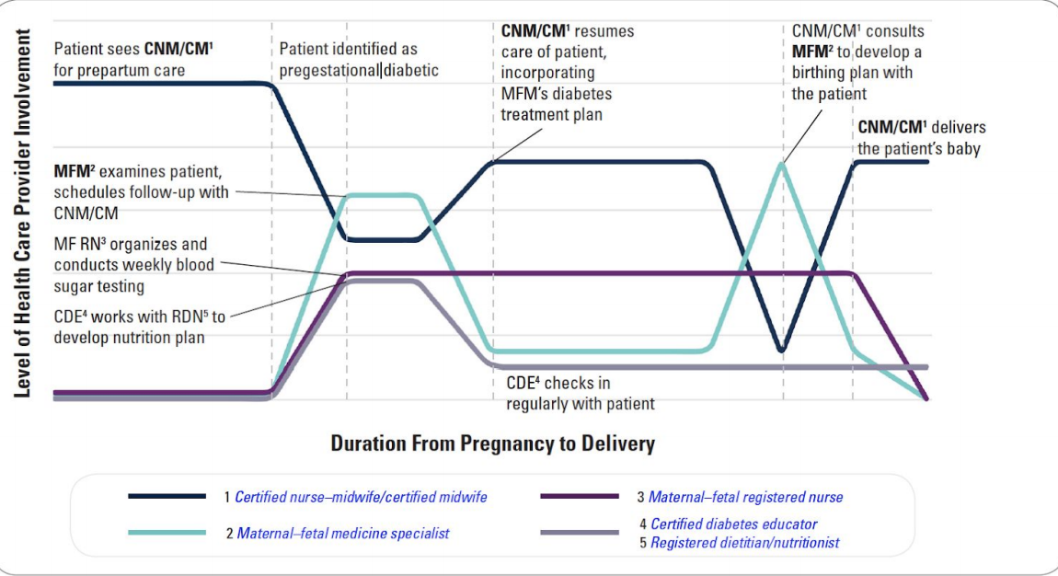
EXAMPLE OF DYNAMIC CLINICAL TEAM LEADERSHIP
Notes:
Measurable processes and outcomes are achieved when the team agrees and implements reliable and timely feedback on successes and failures. This is done while the team is working together towards the team’s goals. Outcomes are used to track and improve performance immediately and over time. Effective team collaboration is evidenced by rigorous, continuous, and deliberate measurements; clearly defined processes and outcomes; and evaluating team functioning and satisfaction. The organizational factors that support measurable processes and outcomes are: continuous improvement in team function and outcomes, development of routine protocols for measurement of team function, and meaningful evaluation of processes and outcomes.
Reference: American College of Obstetricians and Gynecologists (26)

Slide 16
ANTICIPATION OF SHARED RESPONSIBILITY
Florence (Case Study I) & Tasmin (Case Study II):
Tasmin will be away for the remainder of Florence’s pregnancy and birth due to caretaking for an ill parent.
Tasmin refers Florence to Riann for the remainder of her care
Florence has questions for Riann
Tasmin will arrange for a joint visit to assure both Riann and Florence
Notes:
Refer to full text document for more information

Slide 17
CLARIFYING ROLES AND EXPECTATIONS
Examples of when to clarify roles in healthcare are:
when the primary care provider changes
after shift change or during a break relief
when someone outside the team is consulted as part of decision making
after an event when the team’s primary focus has changed (eg. ongoing care after the birth of a baby).
Notes:
Clear expectations about performance help providers identify, measure, and provide feedback about the team’s outcomes. A shared understanding of each other’s responsibilities and accountabilities leads to transparency and seamless collaboration. If you have dual or overlapping roles, determine who can most effectively and efficiently meet the overall objectives of the group while respecting the preferences of the patient. In healthcare, this is determined on a case-by-case basis. If one member of the team has particularly relevant expertise or background, the team may decide to allocate an aspect of care that is not commonly assigned to their professional role. Clearly and openly discussing and documenting roles and responsibilities on an ongoing basis allows teams to define and redefine how they work together in a complex and multi-professional setting

Slide 18
STEPS IN ROLE CLARIFICATION
Role clarification can also be useful when working through the steps in person-centered decision making:
1. Each person describes briefly what they would like to do within the team, including preferred duties and responsibilities
2. Other team members then make requests for each person’s contribution to the team.
3. Feedback, validation, and negotiation are used to establish and define the team’s division of roles. When clarifying your role and your willingness to change based on other members’ role request, there are three options: yes, no, or negotiate.
4. Document what role each person agreed upon.

Slide 19
ESTABLISHING PREFERENCES FOR INFORMATION
Team members share power, share knowledge, and have mutual trust and respect for each other
Team roles needed:
Initiator: a healthcare professional who identifies that a decision needs to be made
Decision Coach: support the client's involvement in decision making; help other providers present the options to patient
Notes:
Clearly-defined roles that support team functioning also support sharing decision making with the client/patient. Ideally, the team members share power, share knowledge, and have mutual trust and respect for each other. Each team needs an Initiator; this is anyone who initiates the PCDM process. Then a Decision Coach is identified to support the client's involvement in decision making; this person is one of the providers on the team (28). Healthcare professionals from at least two different disciplines are involved simultaneously or sequentially in the process with the support of the Decision Coach to conduct a few key elements in the PCDM process.
Knowledge Check to propose to learners:
Which of these are obstacles to person-centered decision making within an interprofessional team? Select THREE from the following.
● Deferring to pre-existing power imbalances
● Applying standardized protocols to a sharing decision making process
● Avoiding discussing conflicting professional worldviews
● Excluding people from the person-centered decision making process
● Assigning a team leader or a Decision Coach

Slide 20
GUIDELINES FOR TEAM FUNCTIONING
Increase fluidity of team functioning
More process-oriented, less task-oriented
Team meetings
Individual member self-awareness
Notes:
Each person in a team contributes to team functioning, but sometimes the degree to which we influence team functioning is not always apparent to us. A simple way to improve team functioning is to become less task-oriented and focus on being more process-oriented. Regular team meetings help to get to know each other and improve communication and relationships. Be mindful of what you carry with you into a team meeting because self-awareness is key to functioning within a team.

Slide 21
SIT TOOL
Notes:
The tool, SIT, describes essential characteristics of team functioning (22). Without them, team members cannot contribute positively to team functioning.
The three elements of SIT are: 1. Safety 2. Inclusion 3. Trust
Trust is essential for people who work together. This is particularly true in healthcare. When you lose trust in another person, safety and inclusion are also lost. So trust is the essential foundation to any healthy working relationship. Teams need to constantly be gauging their own, and each others' sense of safety, inclusion, and trust. If either safety or inclusion are diminished, then return to establishing trust with your team. These three characteristics are mutually dependent and all three need your attention when working with other people

Slide 22
CASE STUDY: LABOR BEGINS
Two weeks before Florence’s EDD, Riann misses the prenatal appointment due to other delivery
Florence expressed anxiety about primary provider absence at impending birth at last visit with Tasmin
Two days after missed prenatal care visit: Florence laboring, Riann now primary provider
Notes:
Refer to full text document for more information

Slide 23
ATTRIBUTES OF HIGH FUNCTIONING TEAMS
All members:
Use clear language, ensure understanding
Organize and convey information in a logical and practical manner
Confirm their own understanding when receiving information from someone else and volunteer relevant information
Focus on the patient's care preferences when conflict arises
Value and seek team input
Display compassion, integrity, and honesty
Regularly engage in critical self-appraisal and welcome feedback on performance
Notes:
To achieve and maintain high-performing healthcare teams, technical skills are not enough. Non-technical skills such as leadership, situational awareness, decision making, task management, and communication are essential (29). High-functioning teams display “a set of social and cognitive skills that support high quality, safe, effective and efficient interprofessional care within the complex healthcare system” (30). Experts have identified social factors as communication and teamwork skills and cognitive factors as personal behaviors and analytic skills (31).
High-functioning teams also possess and apply analytical skills (31). They gather and analyze information to support awareness of risk of errors in the workplace. They identify pragmatic and reasonable solutions available to their team and they re-evaluate their decisions and processes. They are willing and able to change course when significant problems are encountered. These teams encourage active dialogue about situational awareness and discuss and anticipate risks for the team in the future (31)
Knowledge Check to propose to learners:
High-functioning teams rely on these non-technical skills for effective and efficient interprofessional teamwork:
● They rely on social skills, personal behaviors, and analytical skills
● They rely on shared goals, social skills, and decision making skills
● They rely on personal behaviors, team building skills, and institutional leadership
● They rely on communication, teamwork, and social skills

Slide 24
CASE STUDY: LABOR TENSIONS
Florence laboring at home, Tom (partner) tries to notify Riann without success
Florence arrives at hospital with Tom, Riann there to meet them
Florence & Tom unsettled and upset due to lack of contact with Riann
Riann acknowledges their feelings and provides reassurance
Positive rapport begins building
Notes:
Refer to full text document for more information

Slide 25
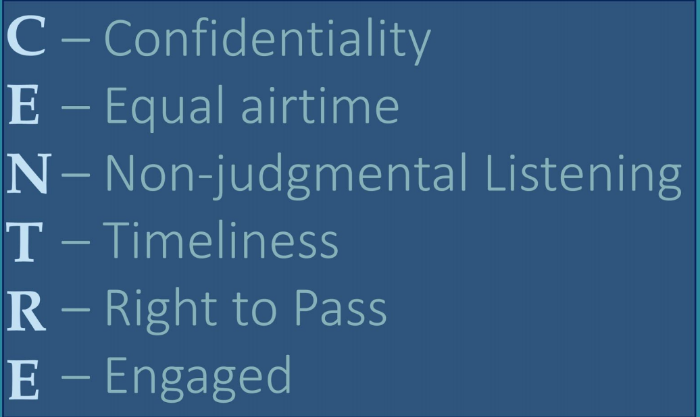
CENTRE TOOL
Notes:
When a new team forms, it is prudent to establish how the team will function. Another tool, CENTRE, is a team guideline that provides direction for clarifying expectations for communication and behaviors (22).
The confidentiality guideline is meant to ensure confidentiality. Discussions that occur among team members at team meetings are confidential and the team should feel secure in their agreements about confidentiality. Each member is expected to to contribute to team decisions and discussions. All contributions should be respected, valued, and considered . This is achieved by providing everyone with equal time for input. You can support this by monitoring your own participation and using group facilitation to ask others for their input. Non-judgmental listening is closely related to equal participation. When someone is contributing their thoughts, there should be an attempt to hear the person and understand their role on the team. You can achieve this by understanding the common ground upon which the team stands. Timeliness is about behavior and expectations within the team. Arriving on time and ending on time are some examples of timeliness within a team. But so are following up on your contributions to the team. Teams function best when each person is accountable to the team and respectful of each other's time and contributions. Right to pass refers to being able to pass on group decision making or giving your input. There may be times that you, or another team member, need to "pass." Teams should be open to members choosing to pass sometimes. There may be good reasons for the person choosing to pass on that decision or taking on that task. When people use their right to pass it should be accepted by the team with no questions asked. Using the right to pass is a right but should not be overused because this may create challenges for teams and team functioning. Being engaged means being an active participant. This can be subtle engagement like using active listening, open and responsive body language, and balancing your time between speaking and seeking input from other members. Disengagement from team members affects team efficiency because more time is spent reviewing or revisiting key discussions and decisions.
Knowledge Check to propose to learners:
A care team has a discussion on whether to proceed with a particular intervention. As team members take turns to voice their opinion, one team member says, "Sure, I don't care." Which CENTRE tool is not being used correctly by this team member?
● Confidentiality
● Equal airtime
● Non-judgmental listening
● Timeliness
● Right to pass
● Engaged

Slide 26
STARTING DIFFICULT CONVERSATIONS
Managing your Reactions to Difficult Conversations: https://youtu.be/EqVh9qWhJvc
Notes:
If your team is not functioning well, or team agreements are not being followed, you may need to approach a team member to discuss their impact on the team's performance. In the following video, Roy Johnson discusses how to manage your anxiety during a difficult conversation.
Knowledge Check to propose to learners:
According to the video, which of the following statements is TRUE?
● Uncomfortable conversations should be avoided because they are awkward.
● Contrary to popular notions, anxiety is not a feeling.
● Entering into fight-or-flight mode can help tackle difficult conversations.

Slide 27
DEAR TOOL
DEAR stands for (32):
Describe what was seen or heard
Explain the impact on you or the team
Ask for their perspective
Request what could be done differently in the future
Notes:
After you manage your reactions and prepare to approach your team member, you will need to learn how to conduct a difficult conversation. Prepare your message by applying the DEAR communication strategy. The DEAR strategy is a mnemonic that helps to frame what message you want to convey when you are having a difficult conversation with someone

Slide 28
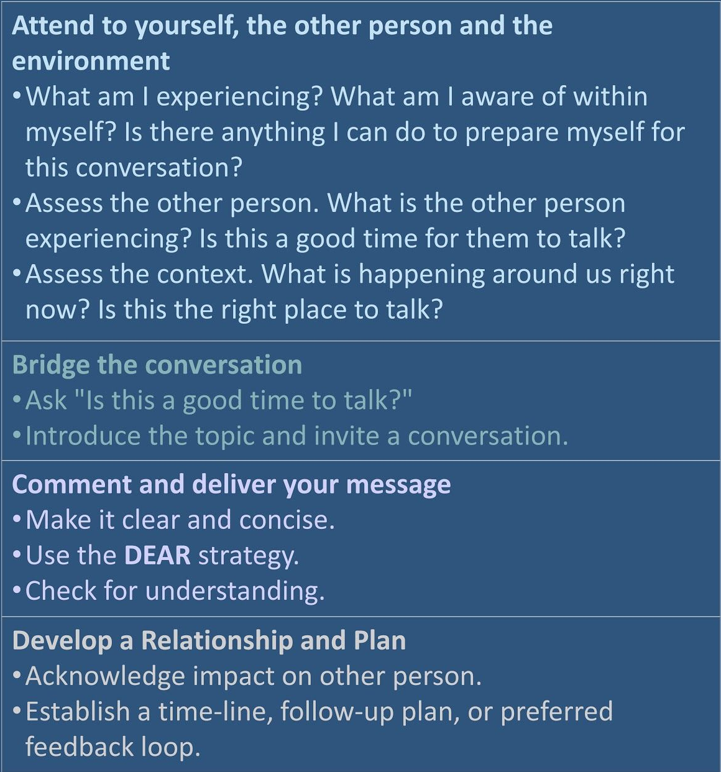
ABCD TOOL
Notes:
After you have prepared yourself using DEAR, prepare to approach the conversation using the ABCD tool (22).

Slide 29
CASE STUDY: CLOSING THE LOOP
Uncomplicated vaginal delivery, Florence expresses positivity about her experience
Riann phones Tasmin to close the communication loop re: Florence
Riann has concerns about Tasmin’s false assertions given to Florence & Tom, plans to discuss with Tasmin
Riann knows to use the ABCD and DEAR approaches to guide the conversation.
Notes:
Refer to full text document for more information

Slide 30
ATTENDING TO POWER IMBALANCES
Power and conflict are dynamics that will affect the way the team functions
Teamwork failures usually originate from non-technical aspects of performance
There are unique challenges to managing human relationships and personalities and power and conflict can explain and predict team dynamics
In situations with perceived hierarchy, people are more likely to defer to that hierarchy and mitigate their speech rather than risk challenging someone in a position of authority
Notes:
The first step in addressing issues of power and conflict in a PCDM process is to acknowledge that they exist and that they may now, or in the future, impact team dynamics. This is done verbally while simultaneously working to create a safe work and safe communication environment. This means inviting contribution from everyone and avoiding assumptions about a team member's experiences, stories, and approaches to decision making. Staying curious will enable a positive team dynamic and avoid team dysfunction

Slide 31
THE DRAMA TRIANGLE AND STAYING CURIOUS
Video
https://youtu.be/lK1llm3w2s0
Stay curious about their concerns
Act, don’t react – don’t become your feelings
Lean in, don’t lean away or charge in
Follow the Platinum Rule, adjusting your approach strategically
Influence using communication
Notes:
In this video by Roy Johnson, you will learn about the drama triangle that can play out within teams and you will learn the skill of staying curious. You can use these skills in order to work together effectively in teams and overcome barriers to team functioning.
Knowledge Check to propose to learners:
How does the drama triangle impact interprofessional collaboration?
● Labeling others helps to clarify roles each person will take when working together.
● Making assumptions about others’ motives discourages role clarification.
● Our constructs of others encourage us to stay curious and collaborate openly.

Slide 32
COLLABORATIVE LEADERSHIP
"Leadership, expertise, and collaboration are fundamental aspects of efficient and effective health care." (WHO, 2005)
"Leadership is defined as a relationship through which one person influences the behavior or actions of other people in the accomplishment of a common task.” (Mullins 2009)
Notes:
When collaborating with an interprofessional group of health care providers, each person is responsible to the client, the group, and their own profession. Shared leadership is an essential skill that must be developed in order to share decision making when collaborating. Providers share accountability for the group’s goals, yet remain individually accountable to their profession. It may seem that the concepts of collaboration and leadership are at odds with each other because often leadership is misinterpreted as "management.”
There are two components of leadership: task-orientation and relationship-orientation (1). In task-orientation, the leader helps other members stay focused on the common goal. In relationship-orientation the leader helps members work more effectively together. In a shared leadership model, clients may choose to serve as the leader or leadership may move among practitioners to provide opportunities for students and new team members to be mentored in the leadership role. In some cases, there may be two leaders: one for practitioners to keep the work flowing and one whose primary role is to serve as the link between the team and the client/family.
To support collaborative practice, practitioners work together to decide who will provide group leadership in a situation by (1): working with others to enable effective client outcomes, advancing interdependent working relationships among all participants, facilitating effective team processes, facilitating effective decision making, establishing a climate for collaborative practice among all participants, co-creating a climate for shared leadership and collaborative practice, applying collaborative decision-making principles, and integrating the principles of continuous quality improvement to work processes and outcomes.
Refer to Guiding Principles Module for more information about interprofessional collaboration

Slide 33
TYPES OF COLLABORATIONS
The multi-disciplinary team: several different health care providers, work independently yet parallel
The interdisciplinary team: formally structured, common goal
The trans-disciplinary team: most collaborative, deliberate exchanges
Notes:
The multi-disciplinary team has several different health care providers that work independently or in parallel. Members make their own decisions about their respective duties. Although they collaborate on the same project, they do not work together. If they do work together, it is on a limited and transient basis. They may never meet, but the infrastructure of the system where they work supports them to work in a sufficiently coordinated fashion. The primary characteristics of this collaborative team are independent working and strong boundaries between members.
The inter-disciplinary team shows a greater degree of collaboration between team members. The team makes an effort to integrate and translate themes and activities shared by several professions. An inter-disciplinary team is usually formally structured and generally has a common goal and decision making process. Inter-disciplinary teams draw on the knowledge and expertise of each team member to solve complex problems in a flexible and open-minded way. Characteristics of this team are teamwork and semi-open boundaries.
The trans-disciplinary team is the most collaborative. Consensus-seeking and broadening of professional boundaries play a major role in this team’s collaboration. In the trans-disciplinary team, there is a deliberate exchange of knowledge, skills, expertise, and decision making that transcends the usual discipline boundaries. In this collaboration, members apply collaborative leadership principles, and boundaries are open

Slide 34
TYPES OF COLLABORATIVE PRACTICES
1. Midwife and physician employed by same organization: Collaboration limited to clinical issues, practice activities. Financial decisions are negotiated between individual clinician and parent organization.
2. Midwife is employed by a physician: Collaborative relationship includes clinical issues and practice activities.
3. Midwife/midwifery group employs physician or has consulting financial arrangement: Collaborative relationship includes clinical issues, practice activities and financial decisions.
4. Midwife and physician in a joint practice, they are financial and clinical partners.
Notes:
Collaboration may occur in team-based care models, but collaboration is also necessary for any consultative relationship between physician and midwife. For example, collaborative partnership is necessary in “parallel” practices as well as in interdisciplinary health care teams. It is important to note that depending on the practice model, effective collaboration may need to exist around the business and financial decision-making, in addition to patient care. Below are some examples (T. King) in the slide.

Slide 35
TRANSFORMATIONAL LEADERSHIP
Encourage heart:
Acknowledge contributions
Celebrate achievements
Enable others:
Establish trust and build strong relationships
Actively engage and empower others
Challenge the process:
Break new ground and discover potential to progress and evolve
Take the risk of failing!
Model the way:
Act as a role model, cultivate integrity
Be transparent and act consistently
Inspire a shared vision:
Exhibit belief and enthusiasm
Enlist and motivate others
Notes:
Since everyone on the team has the potential to become a lead health care provider, each member should have a basic understanding of leadership styles. One style is transformational leadership, which inspires and empowers. Transformational leaders use positive motivation, challenge thinking, and informal rewards (Ralston, 2005). The five elements of transformational leadership are listed above.

Slide 36
REFERENCE LIST
1. Figley C, Huggard P, Rees C. First do no self harm: understanding and promoting physician stress resilience. New York: Oxford University Press; 2013.
2. Health disparities in rural women. Committee Opinion No. 586. American College of Obstetricians and Gynecologists. Obstet Gynecol 2014;123:384–8. Retrieved from: https://www-acog-org.ucsf.idm.oclc.org/Clinical-Guidance-and-Publications/Committee-O pinions/Committee-on-Health-Care-for-Underserved-Women/Health-Disparities-in-RuralWomen
3. Family Medicine Specialty. (n.d.). Retrieved February 26, 2019, from https://www.aafp.org/about/the-aafp/family-medicine-specialty.html
4. Markossian, T. W., Hines, R. B., & Bayakly, R. (2014). Geographic and Racial Disparities in Breast Cancer-Related Outcomes in Georgia. Health Services Research, 49(2), 481–501. https://doi.org/10.1111/1475-6773.12096
5. Products - Data Briefs - Number 84 - January 2012. (n.d.). Retrieved February 26, 2019, from https://www.cdc.gov/nchs/data/databriefs/db84.htm
6. Aspiring Midwives - Association of Midwifery Educators Membership Site. (n.d.). Retrieved February 27, 2019, from https://ame.clubexpress.com/content.aspx?page_id=22&club_id=297046&module_id=28 9334

Slide 37
REFERENCE LIST
7. Definition of Midwifery and Scope of Practice of CNMs and CMs Dec 2011.pdf. (n.d.). Retrieved from: http://www.midwife.org/ACNM/files/ACNMLibraryData/UPLOADFILENAME/0000000002 66/Definition%20of%20Midwifery%20and%20Scope%20of%20Practice%20of%20CNMs %20and%20CMs%20Dec%202011.pdf
8. Essential documents of the national association of certified professional midwives. (2004). National Association of Certified Professional Midwives. Retrieved from http://nacpm.org/Resources/nacpm-standards.pdf
9. Midwifery Led Care is the First Choice for All Women. (2017). International Confederation of Midwives. Retrieved from: https://www.internationalmidwives.org/assets/files/statement-files/2018/04/eng-midwifery -led-care-the-first-choice-for-all-women.pdf
10. Health disparities in rural women. Committee Opinion No. 586. American College of Obstetricians and Gynecologists. Obstet Gynecol 2014;123:384–8. Retrieved from: https://www-acog-org.ucsf.idm.oclc.org/Clinical-Guidance-and-Publications/Committee-O pinions/Committee-on-Health-Care-for-Underserved-Women/Health-Disparities-in-RuralWomen#25
11. The scope of practice of obstetrics and gynecology (2005). Retrieved from https://www.acog.org/About-ACOG/Scope-of-Practice
12. Definition of a Pediatrician. (2015). Pediatrics, 135(4), 780. https://doi.org/10.1542/peds.2015-0056

Slide 38
REFERENCE LIST
13. Eidelman, A. I., Schimmel, M. S., Bromiker, R., & Hammerman, C. (1998). Pediatric coverage of the delivery room: an analysis of manpower utilization. Journal of Perinatology: Official Journal of the California Perinatal Association, 18(2), 131–134. PMID: 9605304. https://www.ncbi.nlm.nih.gov/pubmed/9605304
14. What is a Neonatologist? (n.d.). Retrieved February 27, 2019, from http://www.healthychildren.org/English/family-life/health-management/pediatric-specialist s/Pages/What-is-a-Neonatologist.aspx
15. National EMS scope of practice model. (2007). www.nhtsa.gov: National Highway Traffic Safety Administration. Retrieved from https://www.ems.gov/pdf/education/EMS-Education-for-the-Future-A-Systems-Approach/ National_EMS_Scope_Practice_Model.pdf
16. Scope of practice for international board certified lactation consultant certificants. (2018). Retrieved from https://iblce.org/wp-content/uploads/2017/05/scope-of-practice.pdf
17. Andersen, D., Baird, S., et.al. Acad Quality Management Comm. (2018). Academy of nutrition and dietetics: Revised 2017 scope of practice for the registered dietitian nutritionist. Journal of the Academy of Nutrition and Dietetics, 118(1), 141-165. doi:10.1016/j.jand.2017.10.002
18. NASW standards for social work practice in health care settings. (2016). Retrieved from https://www.socialworkers.org/LinkClick.aspx?fileticket=fFnsRHX-4HE%3d&portalid=0

Slide 39
REFERENCE LIST
19. National Society of Genetic Counselors : Model Legislative Provisions. (n.d.). Retrieved February 27, 2019, from https://www.nsgc.org/p/cm/ld/fid=18#scope
20. Nurse-Family Partnership – Helping First-Time Parents Succeed. (n.d.). Retrieved February 27, 2019, from https://www.nursefamilypartnership.org/
21. Cave D. Care for caregivers while communicating life altering news [Internet]. Vancouver: The University of British Columbia, Centre for Practitioner Renewal; 2017 Jan. 64 p. PowerPoint presentation available from: http://practitionerrenewal.ca/documents/CaringforSelfwhileCommunicatingLifeAlteringNe ws.pdf
22. Kuhl DR, Cave DG, Pearson HM, Whitehead PW. Chapter 14. Treatment and prevention work: center for practitioner renewal. In: Figley C, Huggard P, Rees C, editors. First do no self harm: understanding and promoting physician stress resilience. New York: Oxford University Press; 2013.
23. Naylor MD, Coburn KD, Kurtzman ET, et al. Interprofessional team-based primary care for chronically ill adults: State of the science. Unpublished white paper presented at the ABIM Foundation meeting to Advance Team-Based Care for the Chronically Ill in Ambulatory Settings. Philadelphia, PA; 2010 Mar 24-25.
24. Mitchell PM, Wynia R, Golden B, McNellis S, Okun CE, Webb V, et al. Core principles & values of effective team-based health care. Discussion Paper, Institute of Medicine of the National Academies; 2012; Washington, DC. Available from: https://www.nationalahec.org/pdfs/VSRT-Team-Based-Care-Principles-Values.pdf

Slide 40
REFERENCE LIST
25. Hughes, B, and Rubenstein, B. How to Successfully Integrate Midwives Into Your Practice. Pacific Business Group on Health. San Francisco, CA; 2018.
26. American College of Obstetricians and Gynecologists. Collaboration in Practice: Implementing Team- Based Care. 2016.
27. Murray D. Seven steps to role clarification. Eugene (OR); 2006.
28. Légaré F, Stacey D, Gagnon S, Dunn S, Pluye P, Frosch D, et al. Validating a conceptual model for an inter-professional approach to shared decision making: a mixed methods study. J Eval Clin Pract. 2011 Aug; 17(4): 554-564. Available from http://www.ncbi.nlm.nih.gov/pmc/articles/PMC3170704/
29. Lingard L. Collective competence: adapting our concept of competence to healthcare teams [Internet]. Toronto: The International Conference on Residency Education, Royal College of Physicians and Surgeons of Canada; 2014 Jul. 100 p. PowerPoint presentation available from: http://www.royalcollege.ca/portal/page/portal/rc/common/documents/events/icre/2014pro ceedings/slides/Plenary%20Sessions/Plenary_session_Collective_competence_Adaptin g_our_concept_of_competence_to_healthcare_teams.pdf
30. Yule S, Flin R, Paterson-Brown S, Maran N. Non-technical skills for surgeons in the operating room: a review of the literature. Surgery. 2006;139(2):140-9. Available from: https://www-sciencedirect-com.ucsf.idm.oclc.org/science/article/pii/S0039606005003417

Slide 41
REFERENCE LIST
31. Gordon M, Baker P, Catchpole K, Darbyshire D, Schocken D. Devising a consensus definition and framework for non-technical skills in healthcare to support educational design: a modified Delphi study. Med Teach. 2015;37(6):572-7. Available from: http://web.b.ebscohost.com.ucsf.idm.oclc.org/ehost/pdfviewer/pdfviewer?vid=1&sid=d27 4389b-483b-4e51-a4dd-693aa4e9d88b%40sessionmgr101
32. The Neutral Zone [Internet]. Difficult conversations using DEAR. Vancouver, BC: The Neutral Zone Coaching & Consulting Services Inc. 2014. Available from: www.theneutralzone.ca
33. Janss R, Rispens S, Segers M, Jehn KA. What is happening under the surface? Power, conflict and the performance of medical teams. Med Educ. 2012 Sep;46(9):838-49. Available from: https://www.ncbi.nlm.nih.gov/pubmed/22891905
34. American College of Obstetricians and Gynecologists, Task Force on Collaborative Practice. Collaboration in practice: implementing team-based care. District of Columbia; 2016. 60 p. Available from: http://www.acog.org/Resources-And-Publications/Task-Force-and-Work-Group-Reports/ Collaboration-in-Practice-Implementing-Team-Based-Care
35. The Neutral Zone [Internet]. The drama triangle and staying curious. Vancouver, BC: The Neutral Zone Coaching & Consulting Services Inc. 2014. Available from: www.theneutralzone.ca
36. The Neutral Zone [Internet]. Managing your reactions. Vancouver, BC: The Neutral Zone Coaching & Consulting Services Inc. 2014. Available from: www.theneutralzone.ca

Slide 42
REFERENCE LIST
37. Canadian Interprofessional Health Collaborative. A national interprofessional competency framework. Vancouver: CIHC; 2010 Feb. 36 p. Available from: https://www.cihc.ca/files/CIHC_IPCompetencies_Feb1210.pdf
38. EnHANCE Ontario Project. Healthcare provider’s practice toolkit. Toronto: HealthForceOntario; 2010 Sep. 48 p. Available from:https://odha.on.ca/wp-content/uploads/2017/05/ENHANCE-Providers-Practice-Tool kit.pdf
39. World Health Organization. WHO global strategy on people-centred and integrated health services: interim report. Geneva (CH): WHO Press; 2015. 50 p. Available from: http://apps.who.int/iris/bitstream/handle/10665/155002/WHO_HIS_SDS_2015.6_eng.pdf ;jsessionid=AA86A3CCCE22C0F9579D3EE208702421?sequence=1

