Slide 1
History and Culture of Birth in the U.S.
Sukey Krause, CNM, MSN, Assistant Professor, UMMS-Baystate
Heather Z. Sankey, MD, MEd, FACOG, CPE, Professor, UMMS-Baystate

Slide 2
Objectives
Examine the historic development of midwifery and obstetrics
Understand the genesis of the natural childbirth movement
Describe the culture of birth in the US

Slide 3
Disclosure
This presentation is a general overview of birth in the U.S. It does not comprehensively cover the history or impacts of racism on the professions of midwifery and obstetrics.
Please see presentation on Current State of Childbirth for more information re: impact of racism in midwifery and obstetrics.

Slide 4
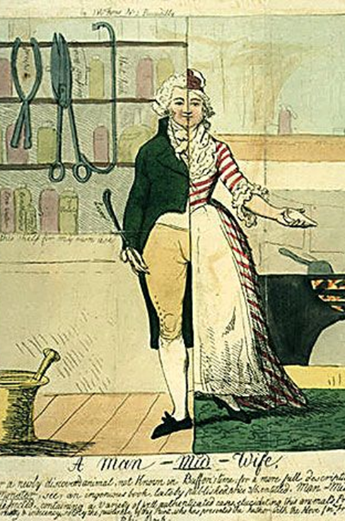
History of Obstetrix 16th-17th c. Europe
Inextricable from male dominance of professions overall
First men in childbirth were considered “male” midwives
Medicine advancing knowledge in anatomy and physiology

Slide 5
History of Obstetrix 16th-17th c. Europe cont.
Barber Surgeons
Professions joined in a single guild
Shared similar “tools of the trade”
Advent of the obstetric forcep
Chamberlen 1588
Groundwork for medical and surgical interventions

Slide 6
History of Obstetrics: 18th c. Europe
Some schools of midwifery existed throughout Europe
Educated males and females separately
William Smellie
Founded first British school of midwifery 1738
Mauriceau–Smellie–Veit maneuver for breech delivery
Obstetrics rejected by mainstream medicine
“ungentlemanly”
“midwifery” not included in medical education
Medical education restricted to men

Slide 7
Midwifery in Europe
Medical schools co-existed with midwifery schools
Dual systems developed for women
Midwives focus normal birth
Physicians focus on complications
End of 19th c. both midwifery and obstetrics existed concurrently

Slide 8
Early White America
Colonial midwives came largely from England
English traditions prevailed
Characteristics of birth
Birth was a social event of female ritual
A midwife was employed, provided housing, had status
Notes:
Wertz RQ, Wertz DC. Lying-In. Chapter 1: “Midwives and social childbirth in colonial America.”
Social event of birth: Gathering of women only, socializing opportunity, supporting, lying-in (post partum period), societal expectation, provide support to others so that others will support you, not only family and acquaintanceship may be have been minor.
Maternal M&M better in US than in England

Slide 9
Obstetrical Practice in the US
19th Century
Most physicians educated in England
Time of great medical advancement
Obstetrics becomes a specialty
Competition between male physicians and female midwives
Late 19th-early 20th c.
Medical practice actively incorporated childbirth
Sequential steps resulted in elimination of traditional midwives
Formal education for midwives opposed
Anti-immigrant sentiment
Notes:
Presenter: See also presentation on Current State of Childbirth that further discusses the consequential results of both obstetrical practice changes as described above and racism in OB-gyn practice.

Slide 10
Early 1900’s: Role of the Midwife Hotly Debated
Pros:
Inclusion of midwives
Necessary adjunct to medical services
Attending normal birth
Formal training recommended
England as exemplar
Expected by “foreigners” and necessary until immigration ceases
Not possible to eliminate
Cons:
“relic of barbarism”
“a drag upon the progress of science and art of obstetrics”
“thousands of young physician” available to do the work of the midwife if it were not considered “undignified”
Educated midwives would lower standards of obstetricians and depress fee for service
“birth is a decidedly pathologic process”
Transactions of the American Gynecological Society, Volume 45, 1915
Notes:
"Society Reports". Medical Record. 88: 1111. December 25, 1915.
Transactions of the American Gynecological Society, Volume 45

Slide 11
Immigrant Midwives
“Perhaps nothing indicates more impressively our contempt for alien customs than the general attitude taken toward the midwife”
Lillian Wald, Founder Henry Street Settlement, 1920
Prejudice relegated native dress to dirty and inability to speak English to ignorance
50% had formal training in country of origin
Austrian, Hungary, Italy, Germany, Russia
Japan

Slide 12
Virtual Eradication of Midwifery in US by Early 1900’s
Lack of access to existing healthcare system
Lack of access to schools
Eliminated access during time of rapidly developing medical science and discoveries
Flexner Report: 1910
Lack of legal recognition and regulation
Lack of national professional organization
Ethnic, racial, and gender discrimination
Shepperd Towner Act: 1921
Distance, poverty, language differences
Notes:
Varney, Thompson
Flexner Report, 1910
Evaluated medical schools to improved physician quality
Schools for African Americans, women closed
“not worth training”
Sheppard-Towner Act
Training of “Granny” midwives by public health nurses
Step toward abolishment of the Granny midwives
Presenter: See also presentation on Current State of Childbirth that further discusses the consequential results of both obstetrical practice changes as described above and racism in OB-gyn practice.
Progressive regulation, education restriction, mandated registration

Slide 13
20th Century Birth
Historically women gave birth at home, supported by female family members, neighbors and midwives.
In the early 20th century, there was a shift to giving birth under medical supervision (in hospitals)
Seeking pain relief
Reassurance from medical experts

Slide 14
“Brought to Bed”
Regular use of obstetrical interventions changed birthing position from upright to recumbent
Instrumental delivery
Episiotomy and repair
Analgesia
Hospital become site of birth
Increased intervention necessitated increased asepsis
Advent of anesthesia
Birth shifted from generalist to specialty
Notes:
Leavitt has a list of the requirements recommended to prepare a home for birth: “. . removal of carpets and draperies, washing furniture in lysol, providing new mattress, new bedding, spraying daily prior to accouchement, cleansing of all attendants, shaving the pubic hair surround the genitalia, sterilizing clothing, instruments, and other accoutrements of the birth room” (pg. 169)

Slide 15
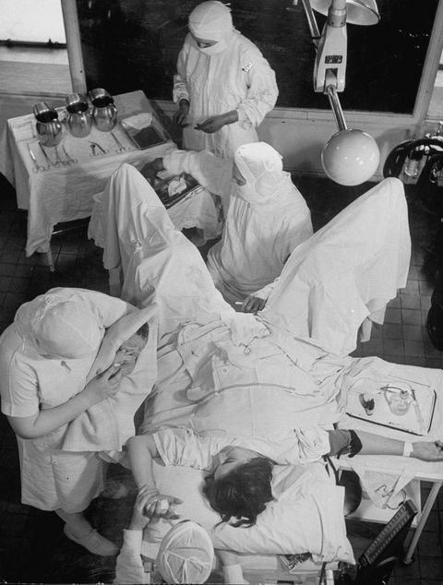
1920s – 1940s
Frequent use of forceps, episiotomies, anesthesia and deep sedation
Physicians did not understand aseptic technique
Infections spread more easily in the hospital
This combination led to increased maternal mortality (although neonatal mortality dropped)
Notes:
75% of births in hospital
https://www.redbookmag.com/body/pregnancy-fertility/g3551/what-it-was-like-giving-birth-in-every-decade/
What it was like giving birth in every decade since the 1900s By Charlotte Hilton Andersen
Jul 28, 2016 accessed 12/2/18

Slide 16
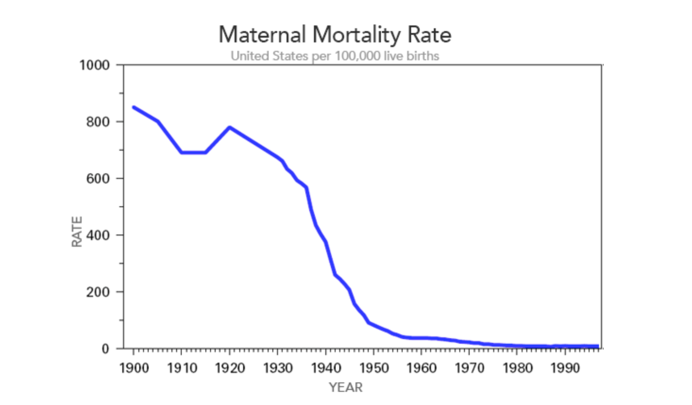
Maternal Mortality Rates in the U.S.

Slide 17
International Trends in Home Birth, 1935-2008

Slide 18
1940’s: Natural Childbirth Movement
Childbirth without Fear was published in England 1933, US in 1944
Redefinition of “Womanhood” following WWII
Growing awareness of the dangers of certain “standard” OB procedures
Spinal anesthesia was introduced in 1940s
Advent of childbirth classes 1950’s and movement towards Natural Childbirth
The “Lamaze” method became popular in the US in 1960s
Notes:
Dr. Grantly Dick-Read, Childbirth without Fear
Published in England 1933, US in 1944
Dick Read proposed that birth pain related to fear, that relaxation reducing pain. “Fear-pain-tension” syndrome
Childbirth and Breastfeeding in 20th-Century America
Jessica Martucci
Subject: Women's History, History of Science and Technology Online Publication Date: Sep 2017 DOI: 10.1093/acrefore/9780199329175.013.428
http://oxfordre.com/americanhistory/view/10.1093/acrefore/9780199329175.001.0001/acrefore-9780199329175-e-428

Slide 19
Gradual Reemergence of Nurse-Midwifery
The first programs were designed to meet needs of specific populations
Maternity Center Association 1921
NYC, Bellevue School for Midwives
Frontier Nursing Service 1926
Eastern Kentucky, delivering care in rural Appalachia
Midwifery school opened in 1939
Tuskegee School of Nurse-Midwifery 1941
Educated black nurses to care for rural AL poor
Catholic Maternity Institute 1941
Provide care to Spanish speaking women of Santa Fe
Concurrently, nurse-midwifery became recognized as non-interventive care providers supportive of natural childbirth techniques
Notes:
Presenter: See also presentation on Current State of Childbirth that discusses the consequential results of educational midwifery changes as described above and racism in midwifery practice.

Slide 20
American College of Nurse- Midwives
Incorporated in 1955
The objectives were simple
To study, develop and evaluate standards for midwifery care of women and infants as provided by certified nurse-midwives (CNMs)
Notes:
http://www.midwife.org/Our-History Accessed 12/2/18
CMs not in original objectives since not recognized until 1996
Of note: nursing as the basis for midwifery is different than the majority of Europe, and the world. Most midwifery is direct entry

Slide 21
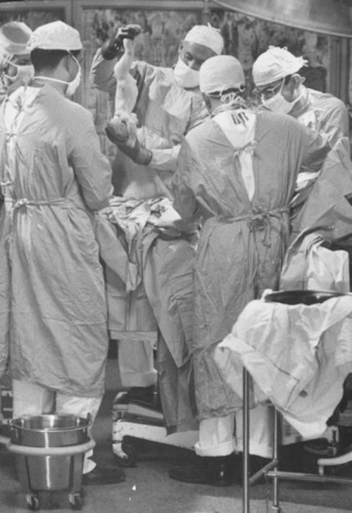
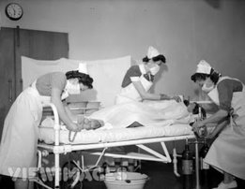
Birth in the 1950’s
90% of births in hospital
Obstetrical Providers
Obstetricians
Family practice physicians
Certified Nurse-Midwives provided home and “maternity home” births
prohibited from hospital birth until 1957
Notes:
King’s County Hospital in Brooklyn was the first to allow CNMs to provide care to women in the hospital setting. John’s Hopkin’s was the second . Cared for indigent women exclusively in hospital setting
Maternity Homes existed for out of hospital birth (now would be called birth centers); La Casita in Santa Fe, Booth Maternity Center in Philadelphia
Josiah Macy Foundation report: 1968, authors agreed that the US hsould make more use of nurse-midwives but only for the care of indigent “The midwife in Regarding their care for the indigent”

Slide 22
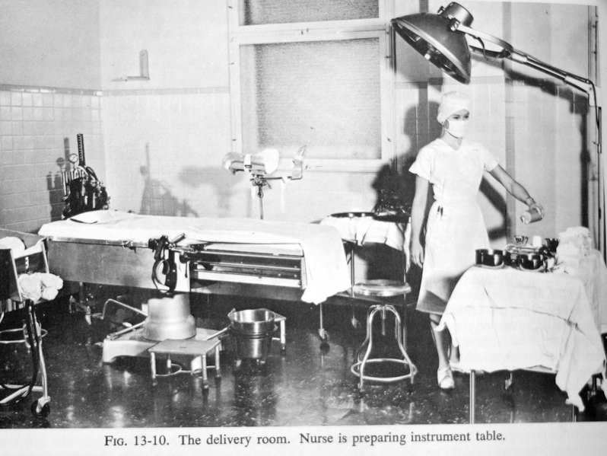
Birth in 1950s
Hospital birth experience
Routine IV and NPO
Routine anesthesia still used
Routine shave prep and enema
Lithotomy positioning
Routine episiotomy
Routine spinal and forceps
Family separation
Partners not allowed in delivery room
Infant and mother separated
Formula feeding encouraged
Long hospital stays on bedrest postpartum

Slide 23
1960s-1980s Natural Childbirth Movement
Women increasingly demanding choice and control
Conscious participation of the mother in her own birthing process
Awake and aware
Active participant
More holistic birth paradigm
Female body is normal in its own right
Notes:
Primarily driven by educated white women
1968: Josiah Macy Foundation Report
Davis Floyd: Birth as an American Rite of passage. Chapter 4: belief systems about birth

Slide 24
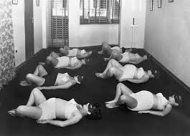
Convergence of Three Movements
Feminist
Natural
Child Birth Consumer
Notes:
Consumer: Women are now purchasing healthcare services and choosing their providers. There is increasing recognition of patient autonomy.
Feminist: The Civil Rights Act of 1964 prohibited discrimination on the basis of gender for the first time. Women’s rights, self-empowerment, The National Organization for Women was founded in 1966. Our bodies, Ourselves was published in 1971

Slide 25
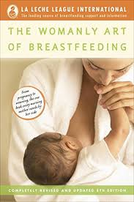
Books that reintroduced the value of physiologic birth
Notes:
Presenter: These are books that changed the culture of childbirth.
Fernand Lamaze. Painless Childbirth, 1950
La Leche League. The Womanly Art of Breastfeeding, 1958
Marjorie Karmel .Thank you, Dr. Lamaze, 1959
Robert Bradley, MD. Husband Coached Childbirth, 1965
Boston Women’s Health Collective. Our Bodies, Ourselves, 1971
Frederick Leboyer, MD. Birth Without Violence, 1975
Ina May Gaskin. Spiritual Midwifery, 1976
Karmel: US woman who travelled to Paris for delivery
Lamaze and Dick-Read emphasized preparedness for labor
Relaxation techniques, visual imagery, breathing
Resurgence of breastfeeding
Bradley introduced “husband coached childbirth”

Slide 26
1980s to 1990s
Shift towards epidurals for pain control in labor
Decrease in routine episiotomies
Shorter hospital stay
Drop in cesarean section rates
Electronic fetal monitoring introduced
44.6% of live births in 1980 to 62.2% in 1988
Notes:
Electronic Fetal Monitoring: Past, Present, and Future RSS
Molly J. Stout MD
and Alison G. Cahill MD, MSCI
Clinics in Perinatology, 2011-03-01, Volume 38, Issue 1, Pages 127-142, Copyright © 2011 Elsevier Inc.
Obstet Gynecol. 1993 Jul;82(1):8-10.
Electronic fetal monitoring in the United States in the 1980s.
Albers LL¹, Krulewitch CJ.

Slide 27
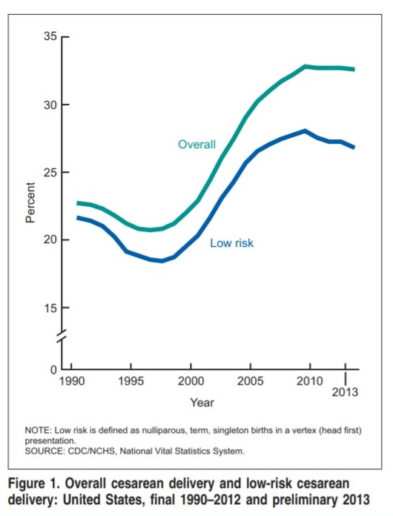
1990s to 2000s
Fetal monitoring becomes routine during labor
Cesarean section rate starts to rise
Births attended by midwives rise from 3.3% to 7.9%
Notes:
In response, Congress enacted the Newborns’ and Mothers’ Health Protection Act of 1996 to mandate 48-hour stays for vaginal births and 96-hour stays for cesarean births unless mother and physician agree to a shorter stay. Both the national OB-GYN and pediatricians associations revised their standards to reflect the new mandates.
Between 1989 and 2012, the proportion of all births attended by certified nurse-midwives (CNMs) increased from 3.3% to 7.9%. The proportion of vaginal births attended by CNMs reached an all-time high of 11.9%. Births attended by "other midwives" (typically certified professional midwives) rose to a peak of 28,343, or 0.7% of all US births. The distribution of payer source for CNM-attended births (44% Medicaid; 44% private insurance; 6% self-pay) is very similar to the national distribution, whereas the majority (53%) of births attended by other midwives are self-pay. Women whose births are attended by other midwives are less likely (13%) to have a prepregnancy BMI in the obese range than women attended by CNMs (19%) or overall (24%).

Slide 28
The Introduction of Evidence
Cochrane Review Midwife-led continuity models of care compared with other models of care for women during pregnancy, birth and early parenting
“Most women should be offered ‘midwife-led continuity of care’.
Decrease incidence of
Epidural use
Episiotomy
Instrumental birth
Preterm birth
No adverse effects
Notes:
From: Cochrane: Midwife-led continuity models of care compared with other models of care for women during pregnancy, birth and early parenting 2016

Slide 29
History Summary
20th century
Later 20th century
Prior to 20th century
Seen as a natural process with high morbidity and mortality
Births attended by Midwives at home
Births attended primarily by physicians in the hospital
Reintroduction of midwifery profession as nurse-midwifery
Shift in thinking back towards a natural process with some pathology
ACOG and ACNM collaborative efforts to bring a balance and learn from each other
Viewed as a pathologic process by obstetricians which needed to be treated –high rate of interventions
Initial increase in morbidity and mortality which improved with aseptic technique
Births at home with midwives or hospital with physicians
21st century
Early 20th century

Slide 30
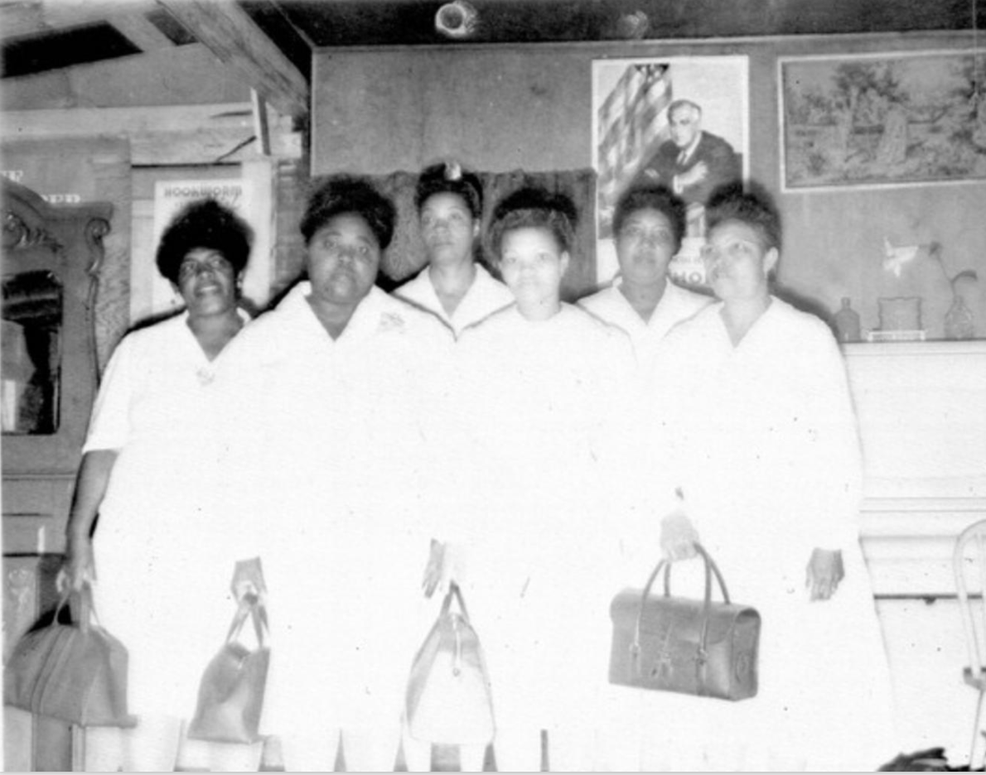
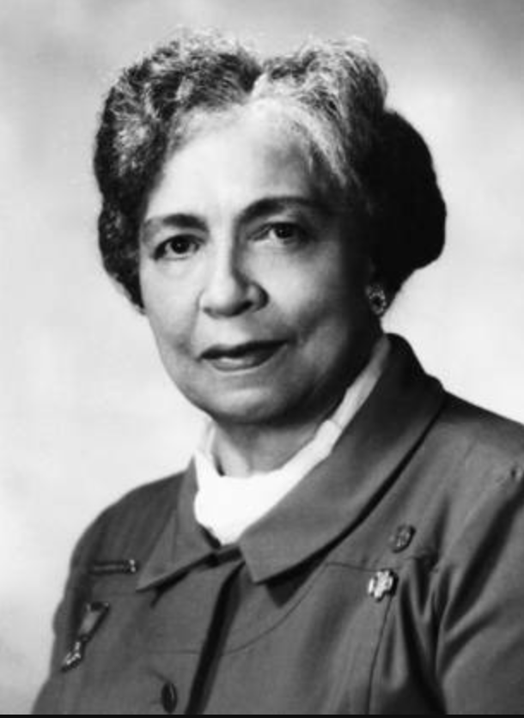
Midwives and Physicians: Culture of Birth

Slide 31
Educational Philosophy
Physician Education
Minimal curricular content on physiologic birth
Major focus on obstetric pathology
A focus on teaching procedures and interventions critical in emergencies but can lead to a view of birth as inherently risky and pathologic
Focused on outcome (healthy mother, healthy baby)
Midwifery Education
Large part of curriculum focused on physiologic birth with screening for pathology
Less focus on interventions and procedures
Major focus on health promotion and disease prevention
Focused on family experience (with expectation of good outcomes)

Slide 32
Birth as Pathologic vs Physiologic
Natural pathology exists:
Iatrogenic pathology also exists:
Gestational hypertensive disorders
Diabetes Obesity
Placental abnormalities
Postpartum hemorrhage
Labor dysfunction
Perineal lacerations from forceps
Episiotomies with extensions
Cesarean section complications (including risks to future pregnancies)
Failure to recognize pathologic changes
Failure to recognize normal physiologic variation
Postpartum hemorrhage
Labor dysfunction
Notes:
Insert Mindy Project clip

Slide 33
Birth as Pathologic vs Physiologic
Physiologic
Physiologic does not include
Spontaneous onset and progression of labor
Results in vaginal birth of infant and placenta
Physiologic blood loss
Promotes optimal newborn transition
Supports early initiation of breastfeeding
Epidural or opiates
Episiotomy
Induction or augmentation
Nutritional deprivation
Restriction of movement
Notes:
J Perinat Educ. 2013 Winter; 22(1): 14–18.
doi: [10.1891/1058-1243.22.1.14]
PMCID: PMC3647729
PMID: 24381472
Supporting Healthy and Normal Physiologic Childbirth: A Consensus Statement by ACNM, MANA, and NACPM*

Slide 34
Location of Birth
AMA, Medial Association House of Delegates 2008
Three separate resolutions to
limit the scope of practice of midwifery
Insure physician oversight of midwives
Promote legislation to ensure all birth occurs in hospitals or birth centers
ACOG Committee Opinion: Planned Home Birth 2017
ACNM Position Statement: Home Birth
12% births by midwives
NICE 2014
For low-risk women in England and Wales
outcomes similar or better in free standing midwifery unit or home vs hospital setting.
Choice of place of birth supported
For low-risk woman in subsequent pregnancy out of hospital birth recommended
>50% births by midwives

Slide 35
Difference in Language Reflects Difference in Orientation
Historical Terminology | Woman-Centered Terminology
“EDC” (estimated date of confinement) | “EDD” or “EDB” (estimated date of delivery or birth)
Patient | Client
Delivery | Birth
Non-compliant | Non-adherent
Failed trial of labor | Unsuccessful trial of labor
Failure to descend | Arrest of descent
Failure to progress | Arrest of labor
Poor obstetrical history | Complicated obstetrical history
Poor maternal effort | Insufficient maternal effort
Failed home birth | Home birth transfer

Slide 36
A Look Around the World
According to WHO: 7.3 million midwives in European Region
12,000 in US
All education is post secondary
Increased education associated increased decision making
No educational standardization
Bachelor’s in Midwifery
3 years: Italy
6 years: Germany
90% female
Remuneration disparities prevail
Women paid less than men in comparable positions
Notes:
http://www.euro.who.int/en/health-topics/Health-systems/nursing-and-midwifery/data-and-statistics

Slide 37
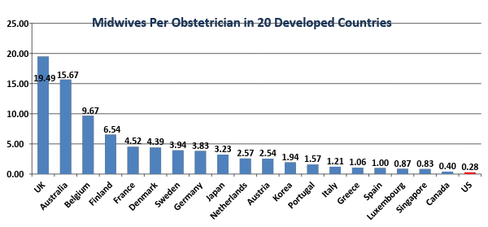
Many Other Countries Incorporate Midwifery Care
Greater use of midwifery in the US should be a significant aspect of addressing the shortage of in skilled maternal care providers.
Used with permission of ACNM
Notes:
Data from Australia are 2005 figures and are from Tim Rowland (BSc), Dr. Deborah McLeod (BSc (Hons), PhD, DipPH) and Natalie Froese-Burns (BA (Hons), M.Econ), (“Comparative Study of Maternity Systems,” Malatest International, Nov. 2012, available at: http://www.health.govt.nz/publication/comparative-study-maternity-systems
Data for Canada, Denmark, Finland, France, Germany, Japan, Korea, Singapore, UK are 2009 figures from Narumi Eguchi, “Do We Have Enough Obstetricians? – A survey of the Japan Medical Association in 15 countries,” JMAJ, May/June 2009, vol. 52, no. 3, pp. 150-157.
Data for Austria, Belgium, Greece, Italy, Luxembourg, Netherlands, Portugal, Spain, Sweden are 2000 figures and are from J.K. Emons, M.I.J. Luiten, “Midwifery in Europe: An Inventory in fifteen EU-member states,” Deloitete & Touche, 2001, available at: http://www.deloitte.nl/downloads/documents/website_deloitte/GZpublVerloskundeinEuropaRapport.pdf
Data for the US are from 2013 and are from the American Midwifery Certification Board (see: http://www.amcbmidwife.org/docs/default-document-library/chart-for-number-of-cnm-cm-by-state---february-2014-present.pdf?sfvrsn=0) and the Association of American Medical Colleges (see: https://members.aamc.org/eweb/upload/14-086%20Specialty%20Databook%202014_711.pdf)

Slide 38
Current perceptions of the health care?
2012 survey of 1000+ US women
85% of women said they were satisfied with their health care, though most said they aren’t getting the services they want, including:
Family planning advice and counseling
Pain management options during childbirth
Choice of birth settings
Most women who have given birth or are pregnant haven’t talked with their providers about:
How to maintain health and wellness during pregnancy
Breastfeeding
Birth control and family planning
Notes:
Presenter: A 2012 survey of more than 1000 US women, developed by the American College of Nurse-Midwives (ACNM), found that there is a major gap between the care women expect from their health care providers and the care they receive.

Slide 39
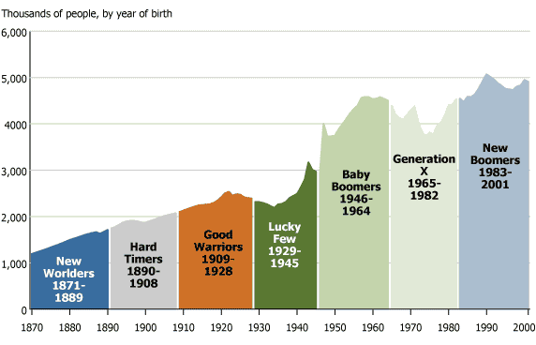
20th Century US Generations
(Population Reference Bureau: www.prb.org)

Slide 40
Reference: Books
Davis-Floyd, RE. Birth as an American Rite of Passage. Berkeley: University of California press; 1992
Leavitt, JW. Brought to Bed. New York: Oxford University Press; 2016
Holmes, JH. Into the Light of Day. New Jersey: LJH Consultancies, 2011.
Milton, J. The American Way of Birth. Penguin Books, New York, NY; 1990
Rooks, J. Midwifery and Childbirth in America. Philadelphia, Temple University Press; 1997
Varney, H. Thompson, JB. The Midwife Said Fear Not: A History of Midwifery in the United States. New York, NY: Spring Publishing. 2016
Wertz, WW. Wertz, DC. Lying-In: A History of Childbirth in America. (Expanded version) Yale University Press: 1989

Slide 41
Reference: Articles
Achievements in Public Health, 1900-1999: Healthier Mothers and Babies. MMWR, 1999. Retrieved from: https://www.cdc.gov/mmwr/preview/mmwrhtml/mm4838a2.htm
ACNM, MANA, NACPM. “Supporting Healthy and Normal Physi9ology Childbirth: A consensus statement by ACNM, MANA, and NACPM.” J Perinat Educ. 2013; 22(1): 14018.
Albers LL, Krulewitch CJ. Electronic fetal monitoring in the United States in the 1980’s. Obset Gynecol. 1993. 82(1): 8-10.
Hilton Anderson CH. What it was like giving birth in every decade since the 1900s, 2016; https://www.redbookmag.com/body/pregnancy-fertility/g3551/what-it-was-like-giving-birth-in-every-decade/
Brodsky, PL. Where have all the midwives gone. The Journal of Perinatal Education. 2008; 17(4); 48-51.

Slide 42
Reference: Articles
Declercq E. Midwife-attended births in the United States, 1990-2012: results of birth certificate data. J Midwifery Womens Health. 2015, 60(1):10-5
Drife, J. The start of life: a history of obstetrics. BMJ. (2002); 78(919)
Martucci J. Childbirth and Breastfeeding in 20th-Century America. In Oxford Research Encyclopedia of American History. September, 2017
Mobbs, N; Williams, C; Weeks, AD. Humanizing birth: Does the language we use matter? The BMJ Opinion. February 8, 2018
Stout MJ, Cahill AG. Electronic Fetal Monitoring: Past, Present, and Future. Clinics in Perinatology, 2011-03-01, Volume 38, Issue 1, Pages 127-142
The Birthplace Lab. Mapping Collaboration Across Birth Setting. University of British Columbia. Retrieved from: http://www.birthplacelab.org/mapping-collaboration-across-birth-settings/

